Slide 1

5.2 Byte Ordering
7
Byte ordering, or endianness, is another architectural consideration
There are two options for storing an integer:
  Little endian machines store the least significant byte before the most significant byte, i.e., the least significant byte is stored at the lower address
  Intel x86 machines (PCs) are little endian
  Big endian machines store the most significant byte before the least significant byte, i.e., the most significant byte is stored at the lower address
  IBM mainframes are big endian

Slide 2
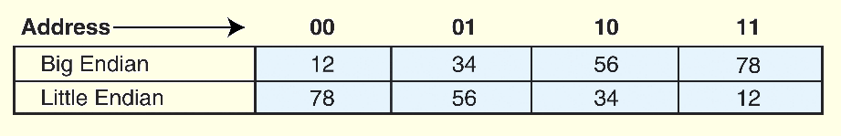
5.2 Byte Ordering
7a
For example, suppose we have the hexadecimal number 12345678.
The big endian and little endian arrangements of the bytes are shown below.
You can see these in files and memory dumps.
  Unix utility od and the emacs editor (for both Unix and Windows) can display files in hex.

Slide 3
5.2 Byte Ordering
8
The big endian architecture has certain advantages
  Regardless of the length of the number, the sign of the number can be determined by looking at the byte at address offset 0.
  Strings and integers are stored in the same order.
The little endian architecture also has certain advantages
  Makes it easier to place values on non-word boundaries.
  Conversion from a 16-bit integer address to a 32-bit integer address does not require any arithmetic
  It can be considered a historical development due to changes in field length

Slide 4
5.2 Byte Ordering
8b
The terms “big endian” and “little endian” come from Jonathan Swift’s Gulliver’s Travels
  Wars were fought over which end of a soft-boiled egg should be up when you crack it.
  It doesn’t matter whether we drive on the left or right side of the road, but for any given set of roads, we have to agree.
Endianness is also called the “NUXI” problem, because the string “UNIX” would be written “NUXI” if it were a number written in little endian format.

Slide 5
5.2 Byte Ordering
8c
Other places where endianness is important
  Endianness is an issue when creating a file to send to another machine
  Endianness is also an issue in networking. Some networking protocols take care of endianness for the user
  Endianness is an issue in Unicode. As long as each character is represented with one byte, there’s no problem, but as soon as characters are represented by multiple bytes, the order must be determined. Unicode uses a special character, the BOM (byte order mark), to indicate endianness.

